Slide 1
Operating Systems CS2006
Lecture 4
Chapter: 2
OS Services & Structures

Slide 2
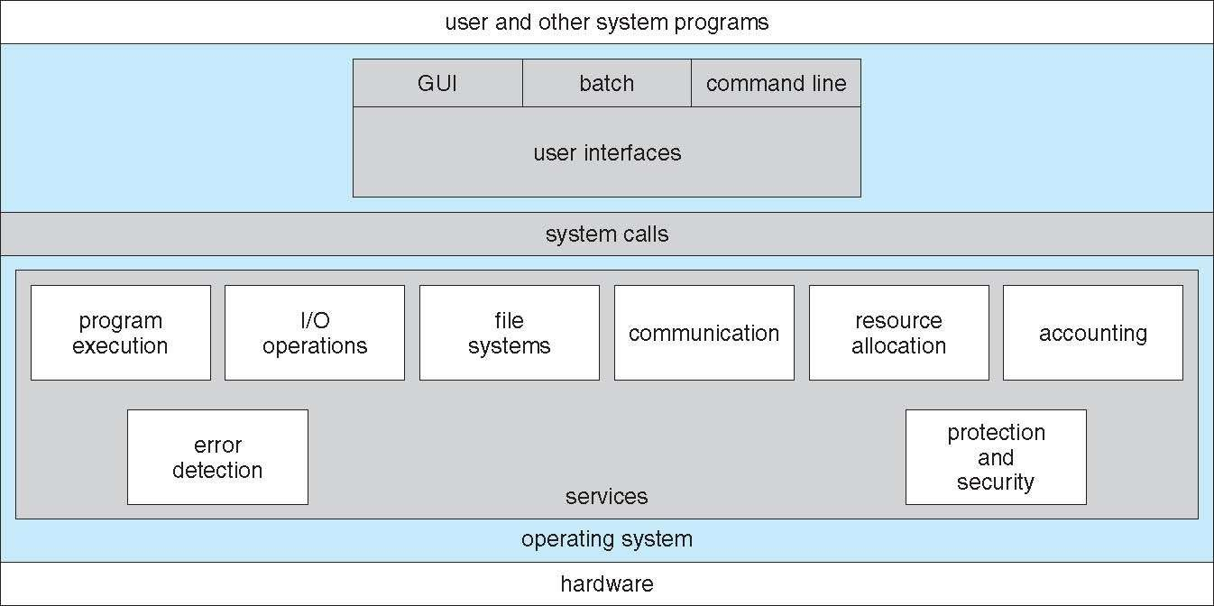

A View of Operating System Services

Slide 3
What Categories of Services Might be Provided by OS?
Program execution
OS Operations
Process management
Memory management
Storage management
I/O Subsystem
Protection & Security

Slide 4
1. Program Execution
Multiprogramming needed for efficiency of utilization
Multiprogramming organizes jobs (code and data) so CPU always has one to execute
A subset of total jobs in system is kept in memory
One job selected and run via job scheduling
When it has to wait (for I/O for example), OS switches to another job
Timesharing (multitasking) is logical extension in which the CPU switches jobs so frequently that users can interact with each job while it is running, creating interactive computing
Response time should be << 1 second
Each user has at least one program executing in memory ➔ process
If several jobs ready to run at the same time ➔CPU scheduling
If processes don’t fit in memory, swapping moves them in and out to run
Virtual memory allows execution of processes not completely in memory

Slide 5
2. OS Operations
Interrupt driven by hardware
Software error or request creates exception or trap
Division by zero, request for operating system service
Other process problems include infinite loop, processes modifying each other or the operating system
Dual-mode operation allows OS to protect itself and other system components
User mode and kernel mode
Mode bit provided by hardware
Provides ability to distinguish when system is running user code or kernel code
Some instructions designated as privileged, only executable in kernel mode
System call changes mode to kernel, return from call resets it to user

Slide 6
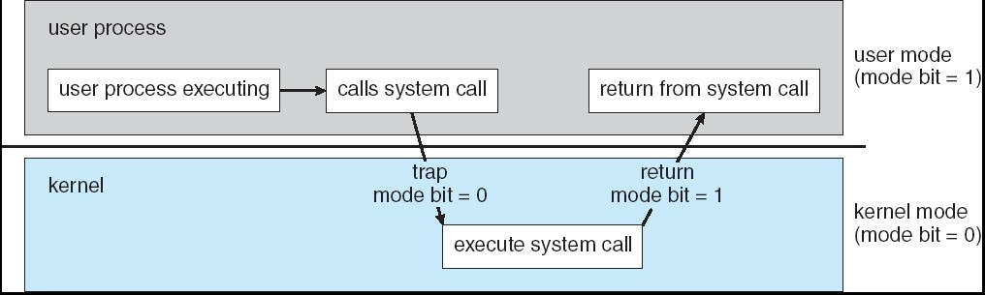
Transition from User to Kernel Mode
Timer to prevent infinite loop / process hogging resources
Set interrupt after specific period
Operating system decrements counter
When counter reaches zero, generate an interrupt
Setup before scheduling process to regain control or terminate program that exceeds allotted time

Slide 7
3. Process Management
A process is a program in execution. It is a unit of work within the system. Program is a passive entity, process is an active entity.
Process needs resources to accomplish its task
CPU, memory, I/O, files
Initialization data
Process termination requires reclaiming of any reusable resources
Single-threaded process has one program counter specifying the location of the next instruction to execute
Process executes instructions sequentially, one at a time, until completion
Multi-threaded process has one program counter per thread
Typically system has many processes, some user, some operating system, running concurrently on one or more CPUs
Concurrency by multiplexing the CPUs among the processes / threads

Slide 8
Process Management Activities
The operating system is responsible for the following activities in connection with process management:
Creating and deleting both user and system processes
Suspending and resuming processes
Providing mechanisms for process communication
Providing mechanisms for process synchronization
Providing mechanisms for deadlock handling

Slide 9
4. Memory Management
Memory management activities
Keeping track of which parts of memory are currently being used and by whom
Deciding which processes (or parts thereof) and data to move into and out of memory
Allocating and deallocating memory space as needed
All data in memory before and after processing
All instructions in memory to allow execution
Memory management determines what is in memory
Optimizing CPU utilization & computer response to users

Slide 10
5. Storage Management
5.1. File-System management
Files usually organized in directories
Access control on most systems to determine who can access what
OS activities include
Creating and deleting files and directories
Primitives to manipulate files and directories
Mapping files onto secondary storage
Backup files onto stable (non-volatile) storage media
OS provides uniform, logical view of information storage
Abstracts physical properties to logical storage unit – file
Each medium is controlled by device (i.e., disk drive, tape drive)
Varying properties include access speed, capacity, data-transfer rate, access method (sequential or random)

Slide 11
5. Storage Management
5.2. Mass-Storage Management
Usually disks used to store data that does not fit in main memory or data that must be kept for a “long” period of time
Proper management is of central importance
Entire speed of computer operation hinges on disk subsystem and its algorithms
OS activities
Free-space management
Storage allocation
Disk scheduling
Disk fragmentation / defragmentation
Some storage need not be fast
Tertiary storage includes optical storage, magnetic tape
Still must be managed – by OS or applications
Varies between WORM (write-once, read-many-times) and RW (read-write)

Slide 12
6. I/O Subsystem
I/O Subsystem responsible for
Memory management of I/O including
Buffering: storing data temporarily while it is being transferred
Caching: storing parts of data in faster storage for performance
Spooling: the overlapping of output of one job with input of other jobs
General device-driver interface
Drivers for specific hardware devices
One purpose of OS is to hide peculiarities of hardware devices from the user
12

Slide 13
7. Protection and Security
Protection – any mechanism for controlling access of processes or users to resources defined by the OS
Security – defense of the system against internal and external
attacks
Huge range, including denial-of-service, worms, viruses, identity theft, theft of service
Systems generally first distinguish among users, to determine who can do what
User identities (user IDs, security IDs) include name and associated number, one per user
User ID then associated with all files, processes of that user to determine access control
Group identifier (group ID) allows set of users to be defined and controls managed, then also associated with each process, file
Privilege escalation allows user to change to an effective ID with more rights

Slide 14
System Calls

Slide 15
System Calls
Programming interface to the services provided by OS
Typically written in a high-level language (C or C++)
Mostly accessed by programs via a high-level Application Program Interface (API) rather than direct system call use
Three most common APIs are Win32 API for Windows, POSIX API for POSIX-based systems (including virtually all versions of UNIX, Linux, and Mac OS X), and Java API for the Java virtual
machine (JVM)
Why use APIs rather than system calls?

Slide 16
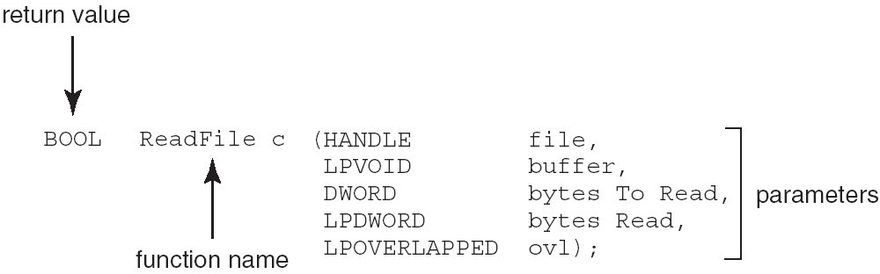
Example of Standard API
ReadFile(): Win32 API—a function for reading from a file
A description of the parameters passed to ReadFile()
HANDLE file—the internal handle of the file to be read
LPVOID buffer---A buffer where the data will be read into and written from
DWORD bytesToRead—the number of bytes to be read into the buffer
LPDWORD bytesRead—the number of bytes read during the last read
LPOVERLAPPED ovl—indicates if overlapped I/O is being used

Slide 17
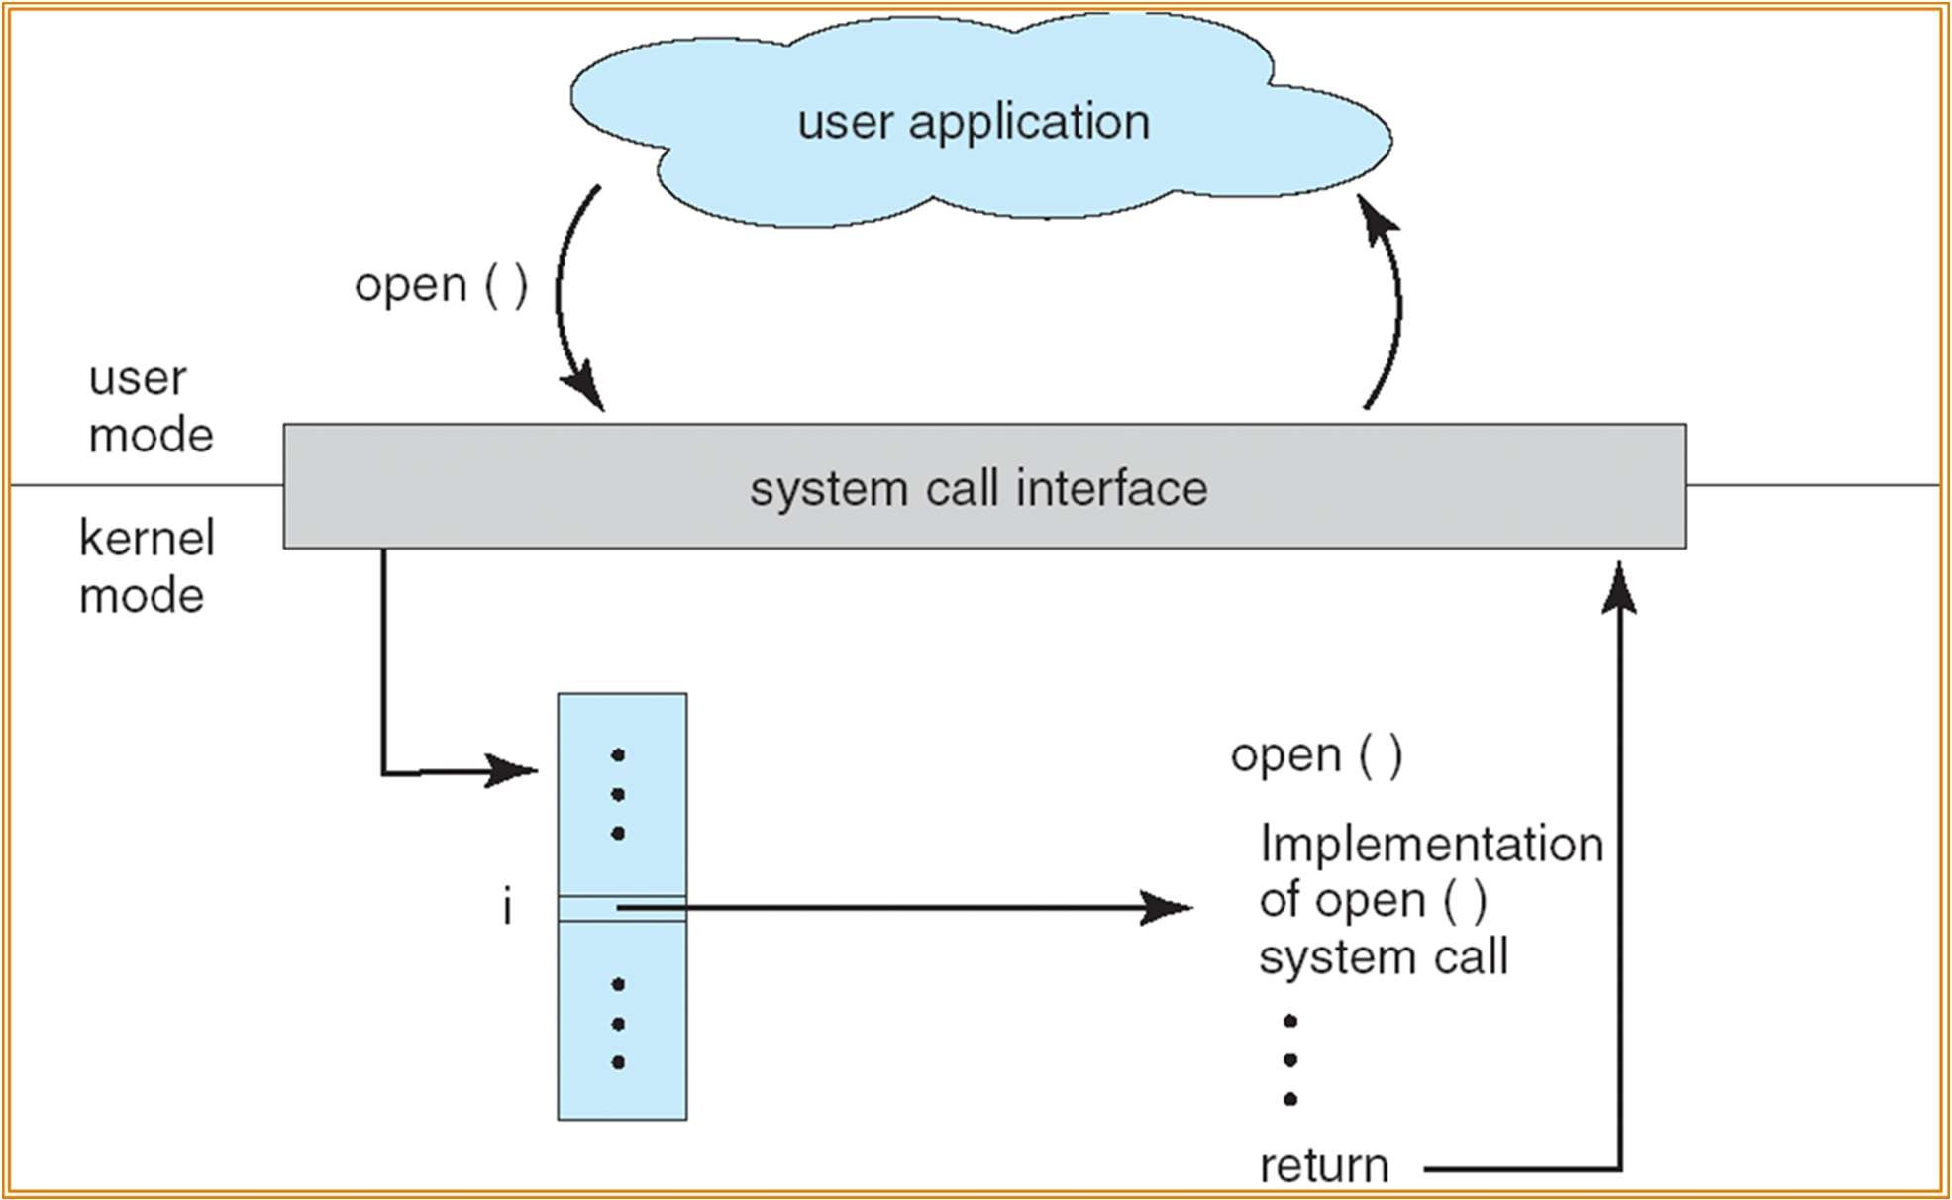
API – System Call – OS Relationship

Slide 18
System Call Implementation
Typically, a number associated with each system call
System-call interface maintains a table indexed according to these numbers
The system call interface invokes intended system call in OS
kernel and returns status of the system call and any return values
The caller need know nothing about how the system call is implemented
Just needs to obey API and understand what OS will do as a result of the call
Most details of OS interface hidden from programmer by API
 Managed by run-time support library (set of functions built into libraries included with compiler)

Slide 19
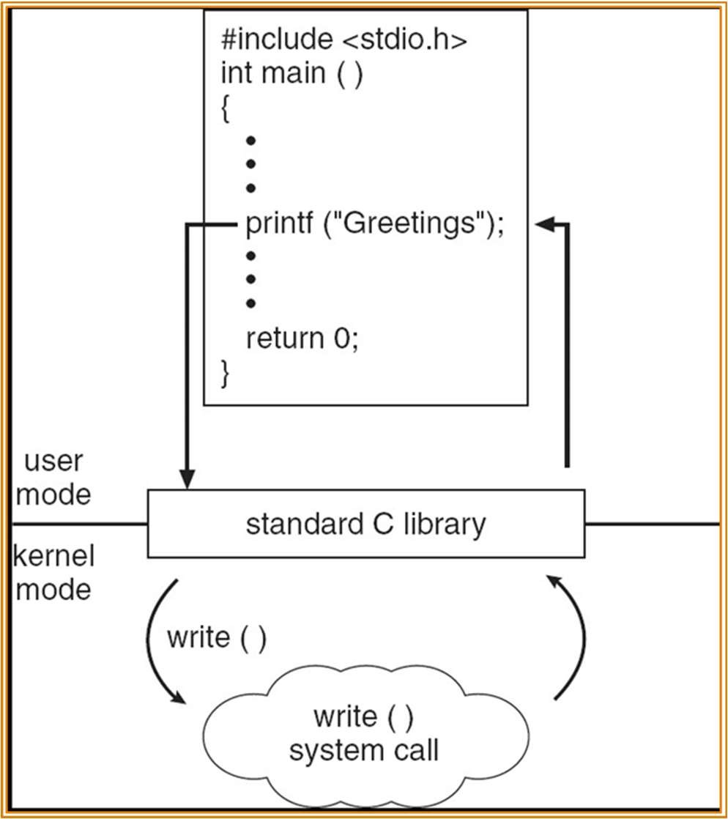
Standard C Library Example
 C program invoking printf() library call, which calls write() system call
20
CS-2006 Operating Systems

Slide 20
System Call Parameter Passing
Often more information is required than simply identity of desired system call
Exact type and amount of information vary according to OS and call
Methods used to pass parameters to OS
Simplest: pass the parameters in registers
 In some cases, may be more parameters than registers
Parameters stored in a block, or table, in memory, and address of block passed as a parameter in a register
 This approach taken by Linux and Solaris
Parameters placed, or pushed, onto the stack by the program and popped off the stack by the operating system
Block and stack methods do not limit the number or length of parameters
being passed
21

Slide 21

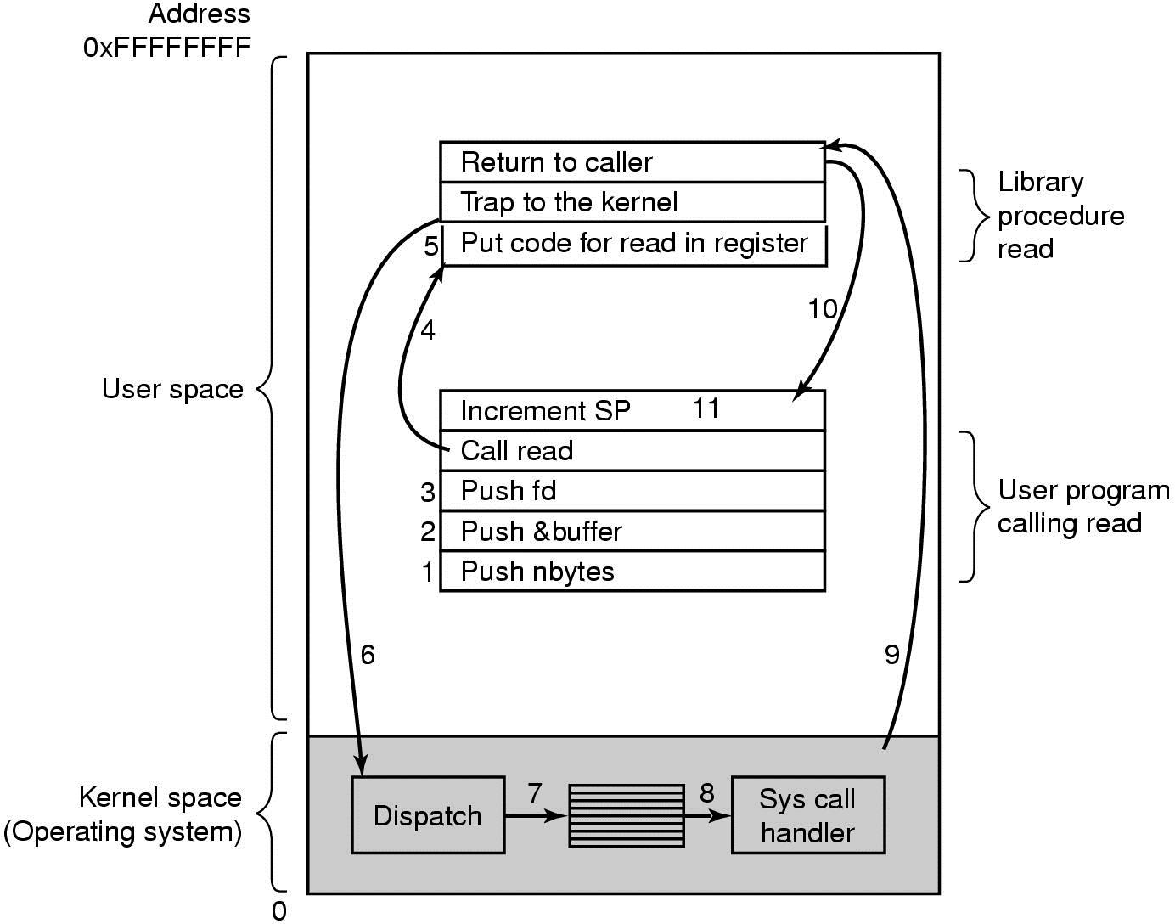
Invoking a System Call
count = read (fd, buffer, nbytes);

Slide 22
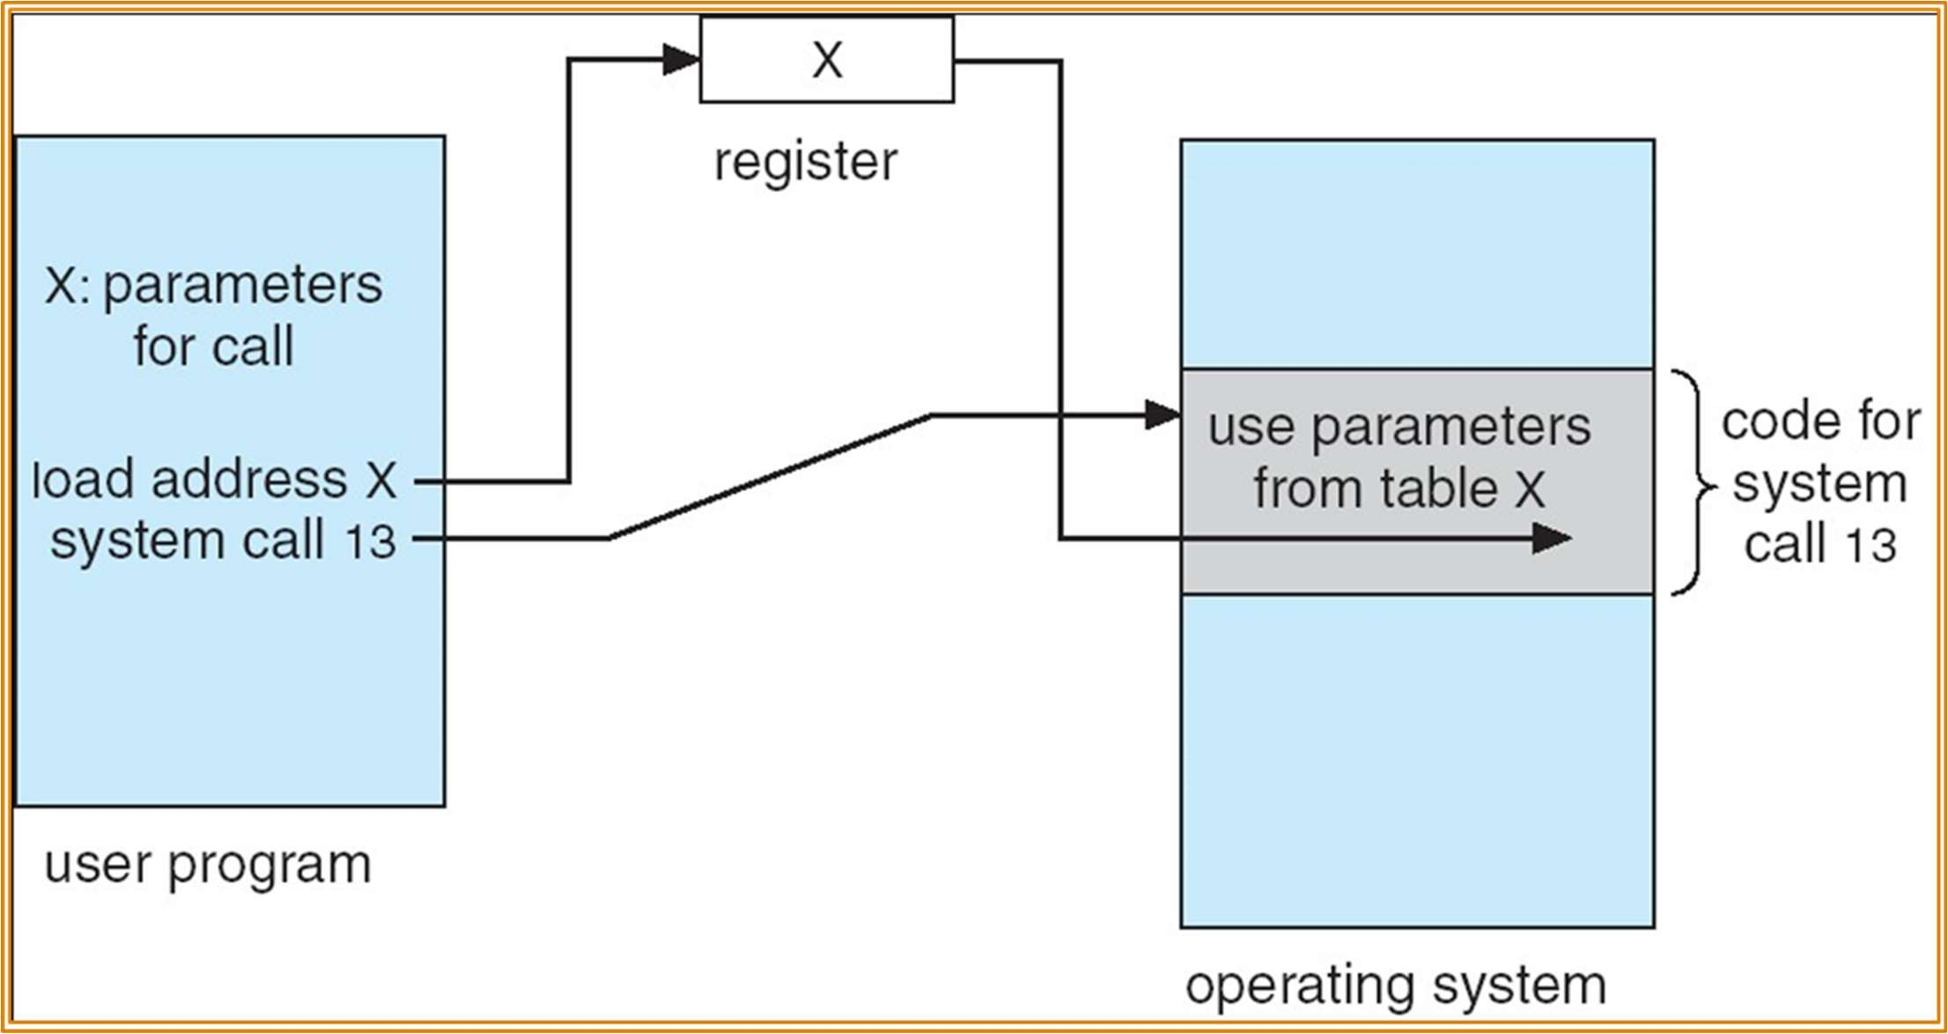
Parameter Passing via Table
22
CS-2006 Operating Systems

Slide 23
Types of System Calls
Process control
File management
Device management
Information maintenance
Communications
23
CS-2006 Operating Systems

Slide 24
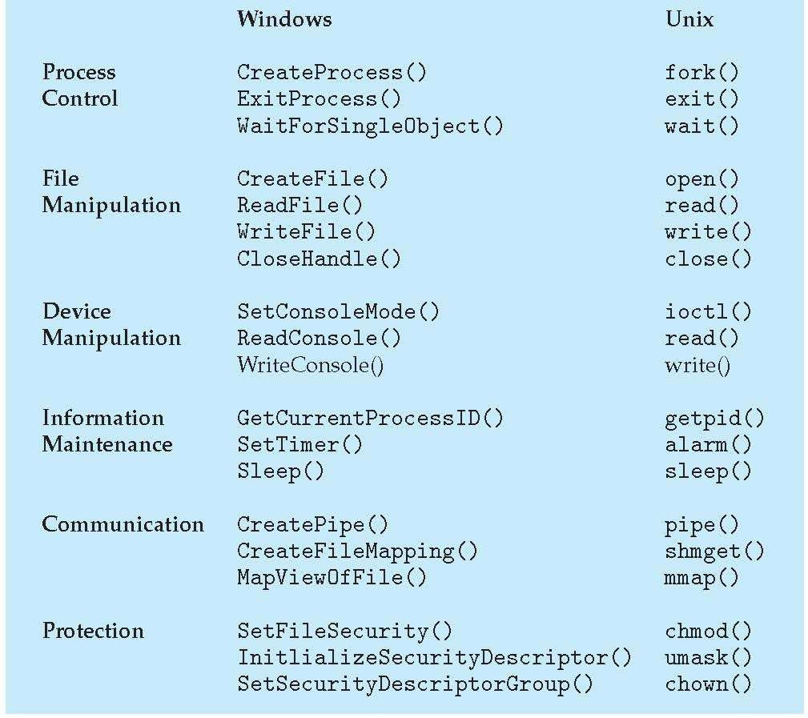
Examples of Windows and Unix System Calls
24

Slide 25

User Interface
25

Slide 26
User Operating System Interface - CLI
Command-Line Interface (CLI) allows direct command entry
Sometimes implemented in kernel, sometimes by systems program
Sometimes multiple flavors implemented – shells
Primarily receives command from user and executes it
Sometimes commands built-in, sometimes just names of programs, sometimes a combination
If the latter, adding new features doesn’t require CLI
modification
26

Slide 27
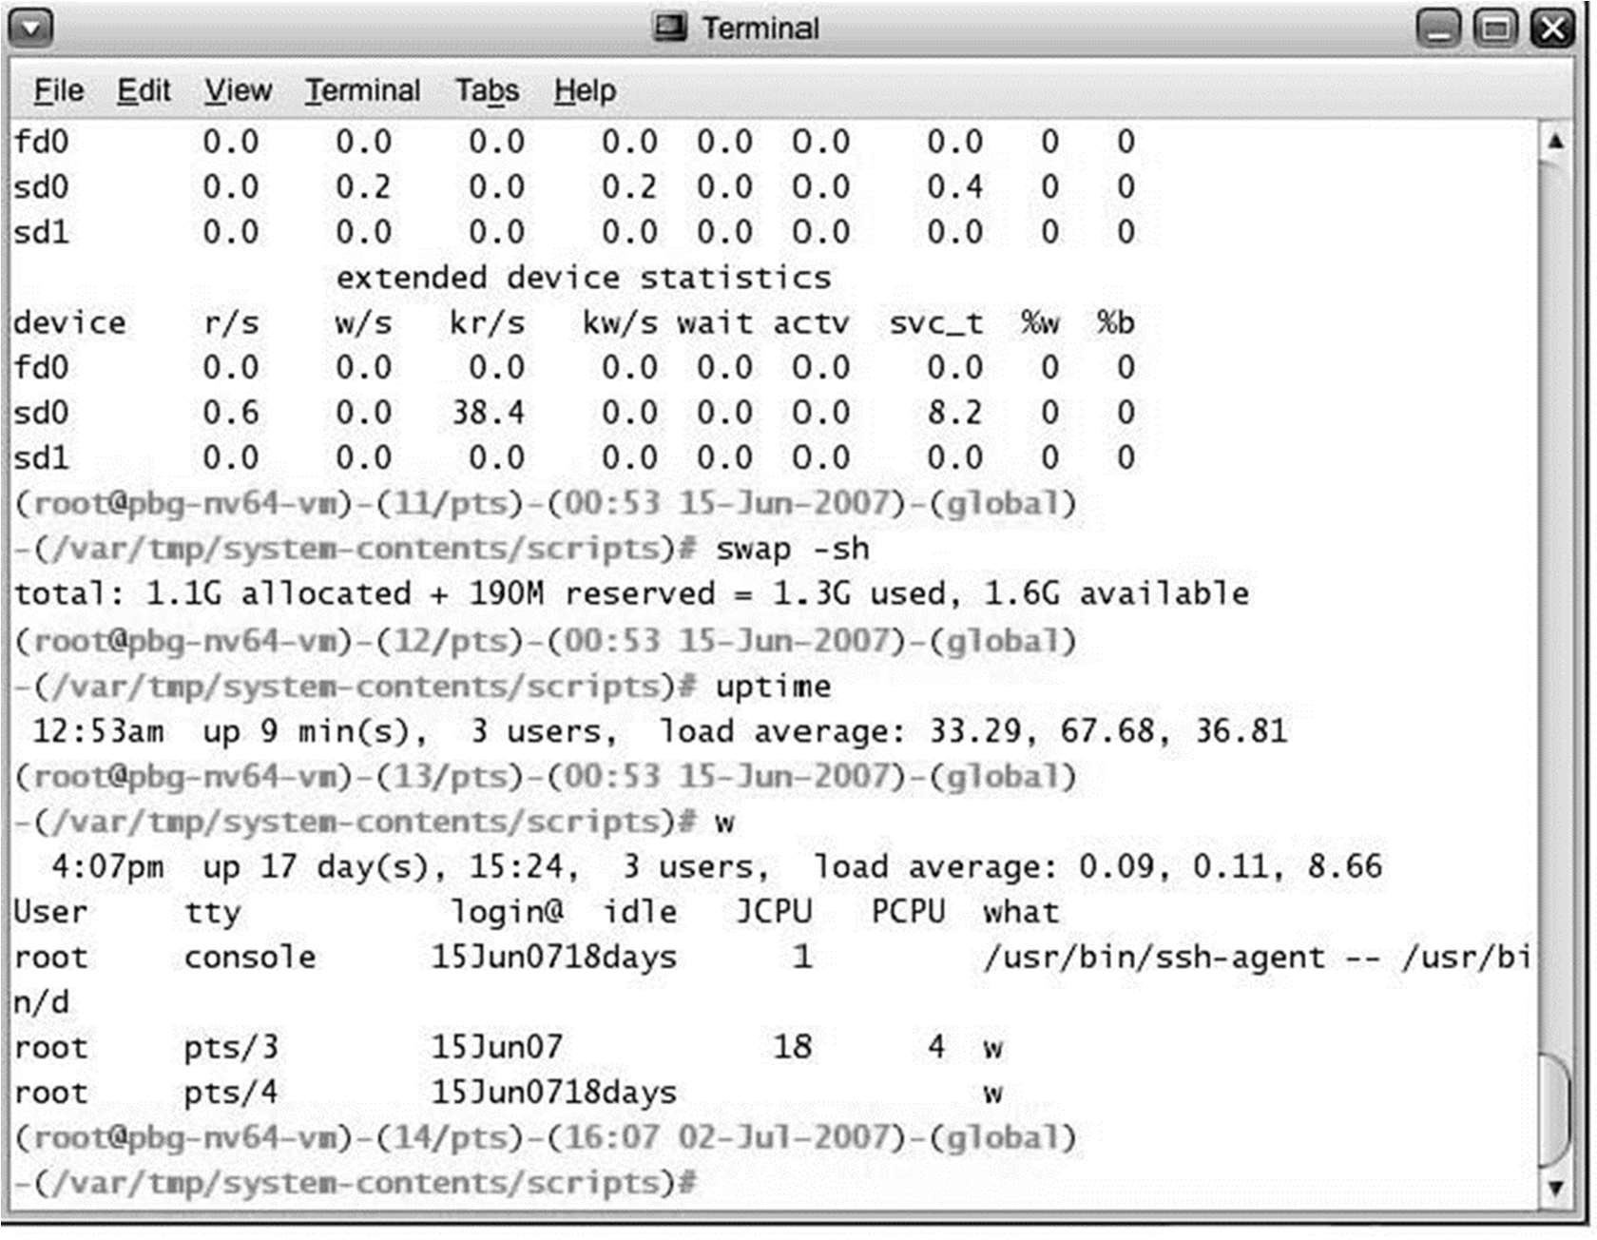
Bourne Shell Command Interpreter
27
CS-2006 Operating Systems

Slide 28
User Operating System Interface - GUI
User-friendly desktop metaphor interface
Usually mouse, keyboard, and monitor
Icons represent files, programs, actions, etc
Various mouse buttons over objects in the interface cause various actions (provide information, options, execute function, open directory (known as a folder)
Invented at Xerox PARC
Many systems now include both CLI and GUI interfaces
Microsoft Windows is GUI; CLI is “command” shell
Apple Mac OS X has “Aqua” GUI; UNIX kernel underneath and multiple shells available
Solaris has multiple GUIs; CLI is multiple shells
28

Slide 29

User and System Programs
29

Slide 30
System Programs
System programs provide a convenient environment for program development and execution. Including:
File manipulation
Status information
Programming language support
Program loading and execution
Communications
Application programs
Most users’ view of the operating system is defined by system programs, not the actual system calls
30

Slide 31
OS Structures
31

Slide 32
Operating System Design and Implementation
Affected by choice of hardware, type of system
User goals and System goals
User goals – operating system should be convenient to use, easy to learn, reliable, safe, secure, and fast
System goals – operating system should be easy to design, implement,
and maintain, as well as flexible, reliable, error free, secure, and efficient
Important principle is separation
Policy: What will be done?
Mechanism: How to do it?
The separation of policy from mechanism is a very important principle, it allows maximum flexibility if policy decisions are to be changed later

Slide 33
Operating Systems Structures
Structure/Organization/Layout of OSs:
Monolithic (one unstructured program)
Layered
Microkernel
Virtual Machines
The role of Virtualization

Slide 34
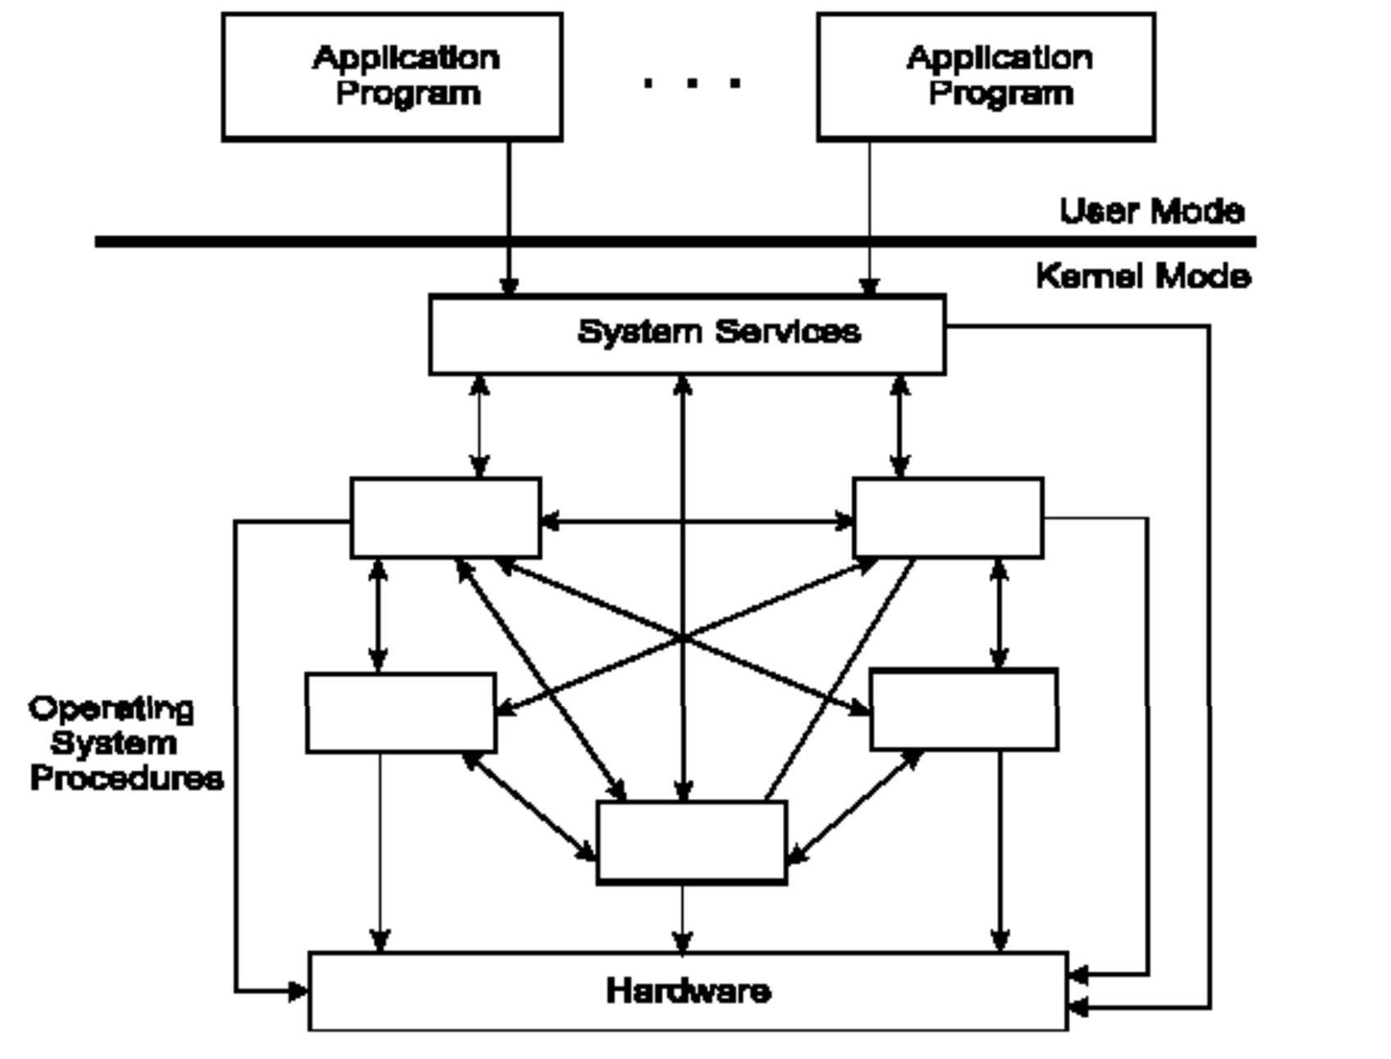
1. Monolithic Operating System

Slide 35
Monolithic OS – Basic Structure
Application programs that invoke the requested system services.
A set of system services that carry out the operating system procedures/calls.
A set of utility procedures that help the system services.

Slide 36
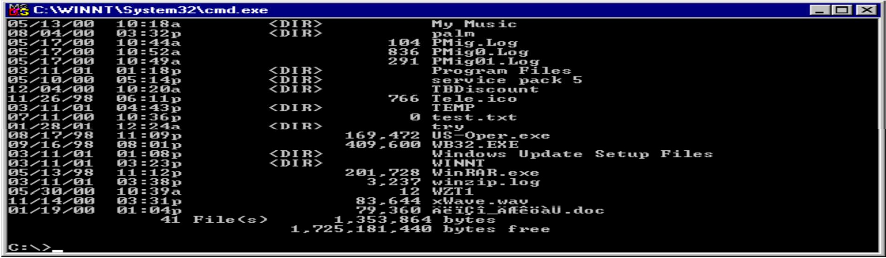
MS-DOS System Structure
MS-DOS – written to provide functionality in the least space:
not divided into modules (monolithic).
Although MS-DOS has some structure, its interfaces and levels of functionality are not well separated.

Slide 37
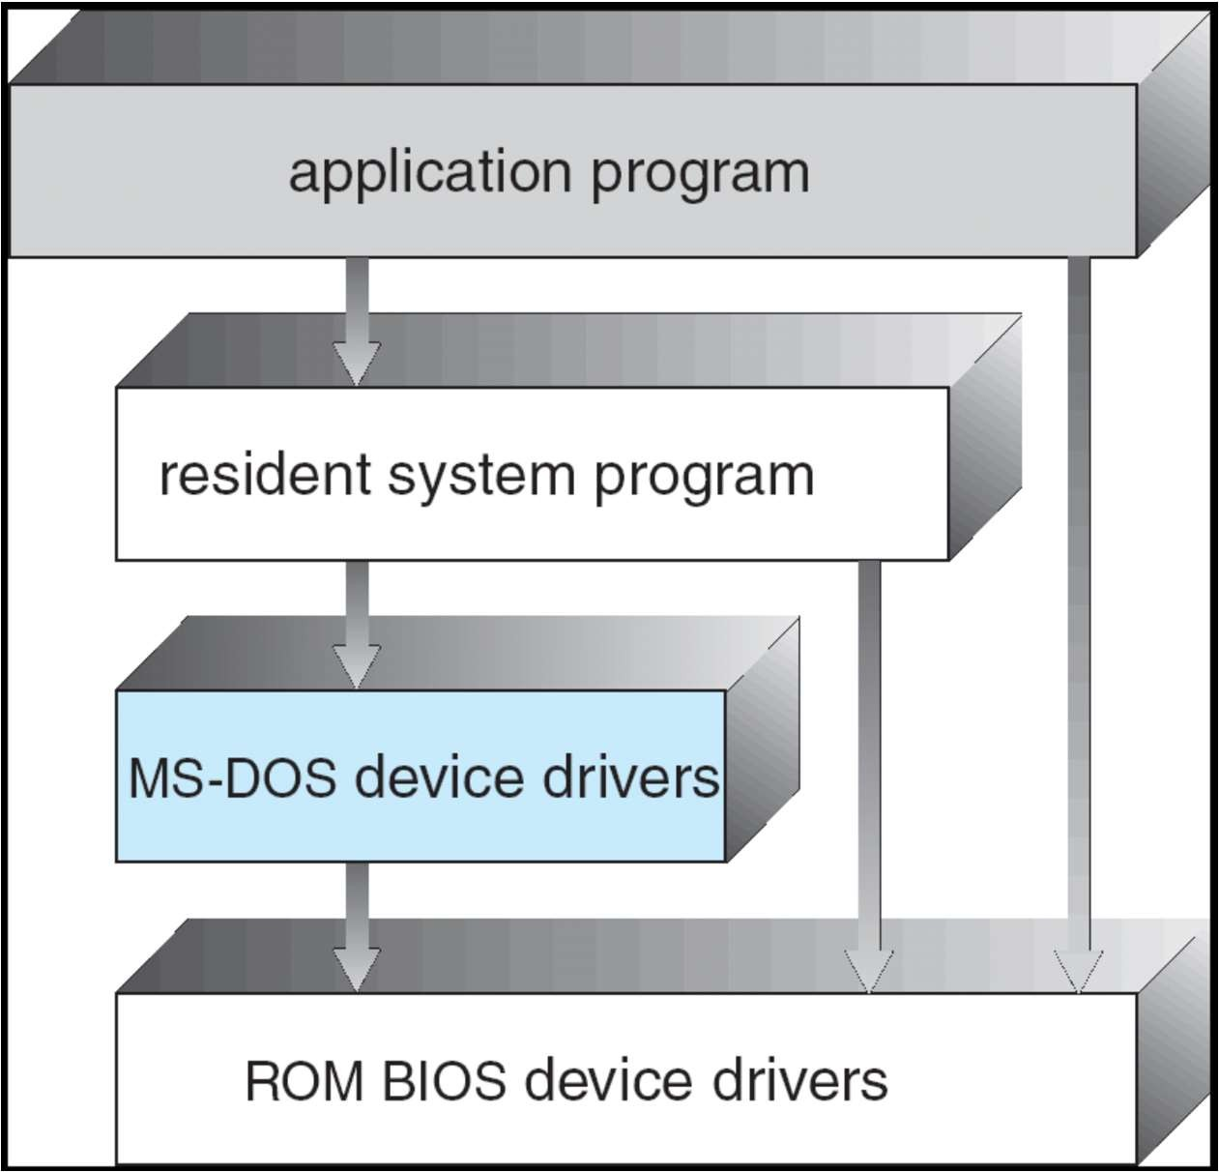
MS-DOS Layer Structure
37
CS-2006 Operating Systems

Slide 38
UNIX System Structure
UNIX – limited by hardware functionality, the original UNIX operating system had limited structuring. The UNIX OS consists of two separable parts
The kernel
Consists of everything below the system-call interface and above the physical hardware
Provides the file system, CPU scheduling, memory management, and other operating-system functions; a large number of functions for one level
Systems programs

Slide 39
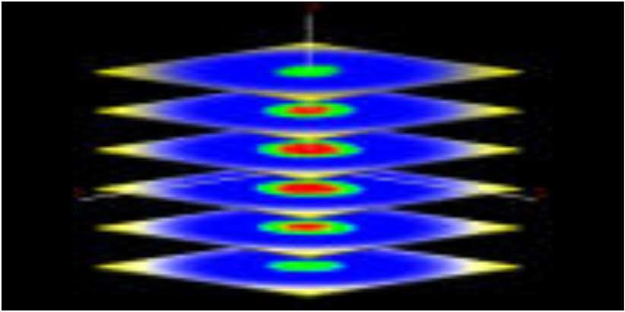
2. Layered Approach
The operating system is divided into a number of layers (levels), each built on top of lower layers
The bottom layer (layer 0) is the hardware; the highest (layer
N) is the user interface
With modularity, layers are selected such that each uses functions (operations) and services of only lower-level layers

Slide 40
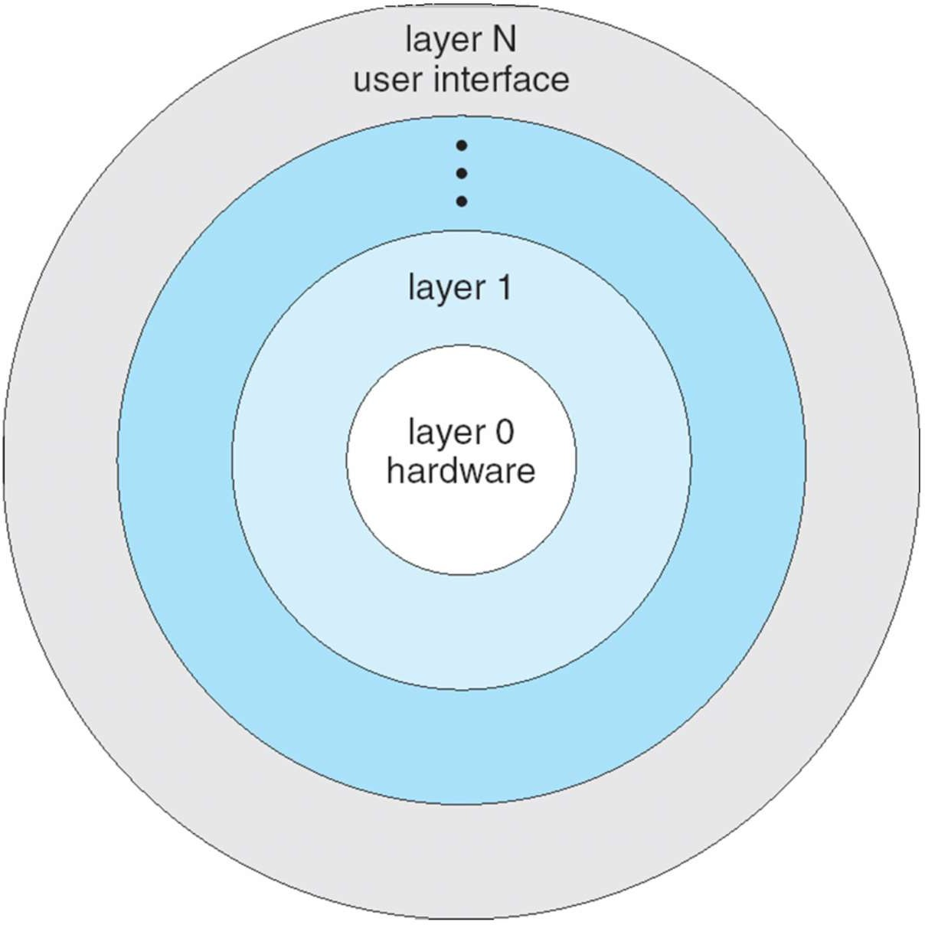
Layered Operating System
40
CS-2006 Operating Systems

Slide 41
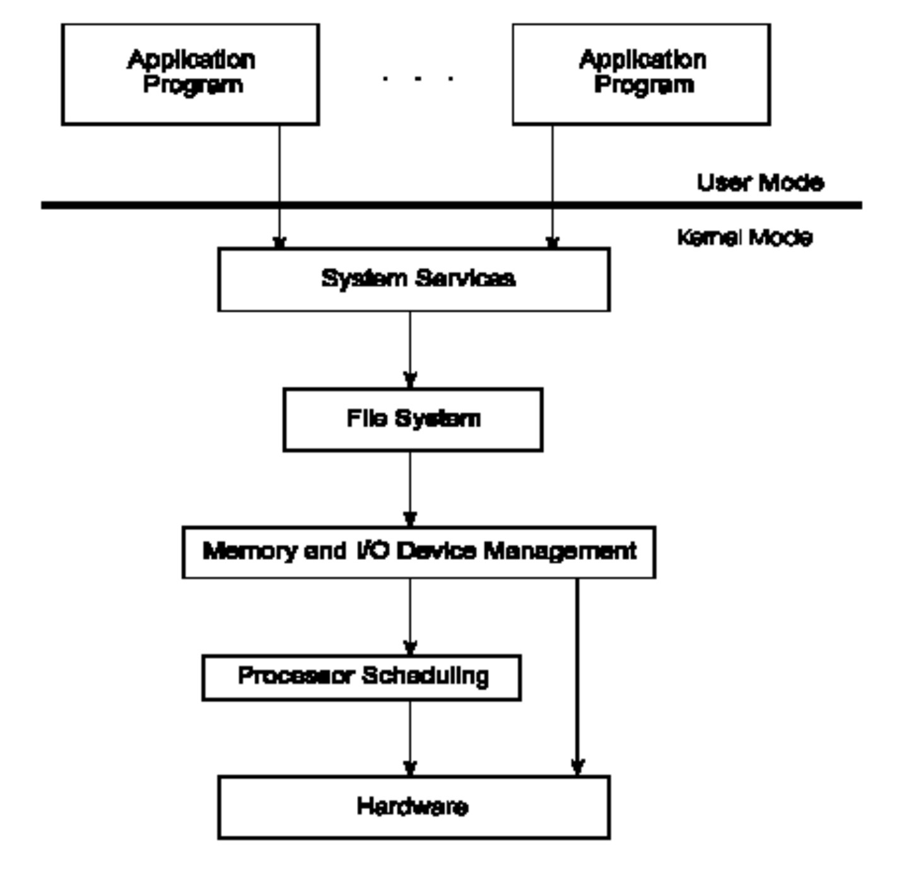
Operating System Layers
41
CS-2006 Operating Systems

Slide 42
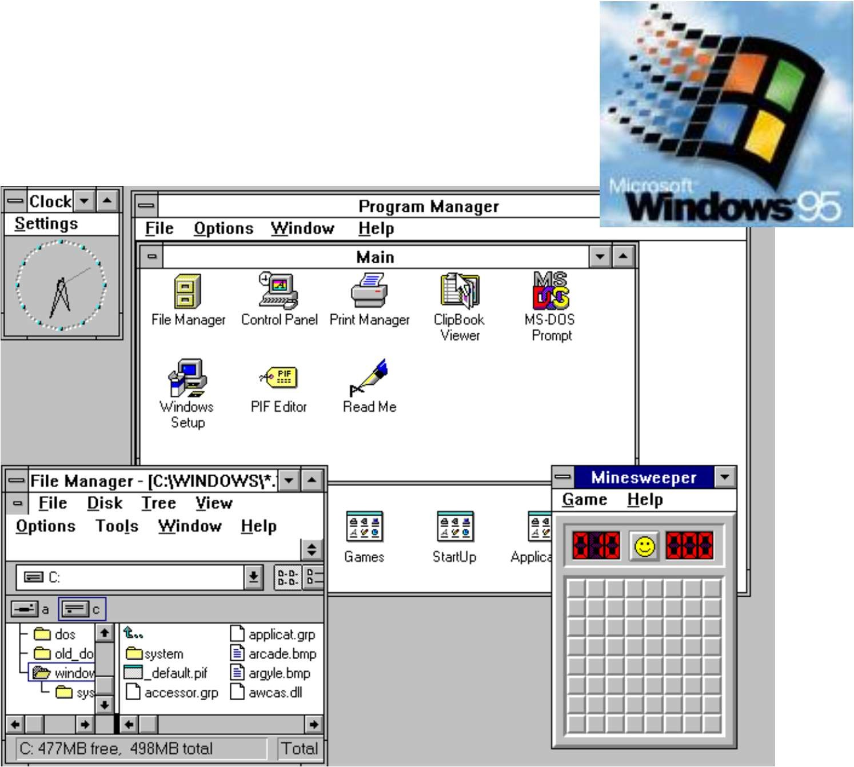
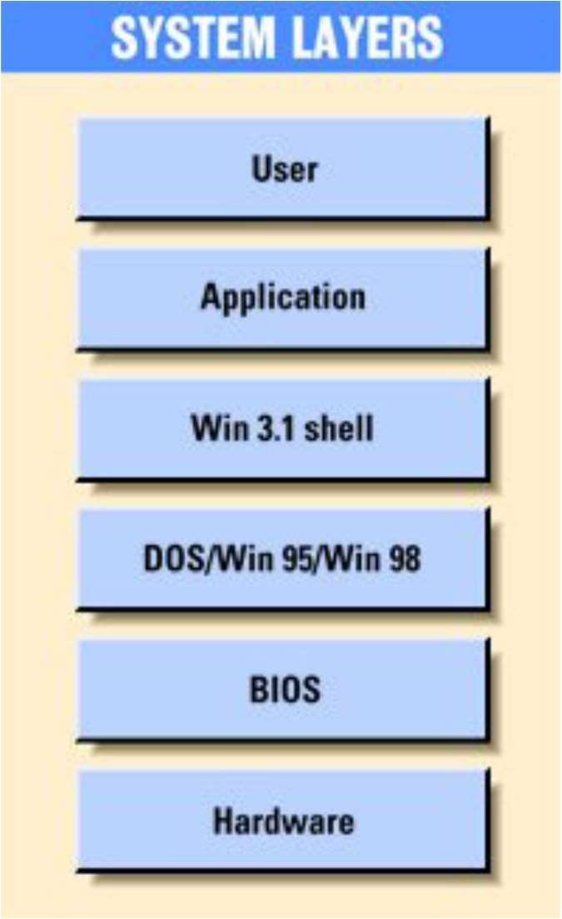
Older Windows System Layers
42
CS-2006 Operating Systems

Slide 43
3. Microkernel System Structure
Move as much functionality as possible from the kernel into “user” space.
Only a few essential functions in the kernel:
primitive memory management (address space)
I/O and interrupt management
Inter-Process Communication (IPC)
basic scheduling
Other OS services are provided by processes running in user mode (vertical servers):
device drivers, file system, virtual memory…
43
CS-2006 Operating Systems

Slide 44
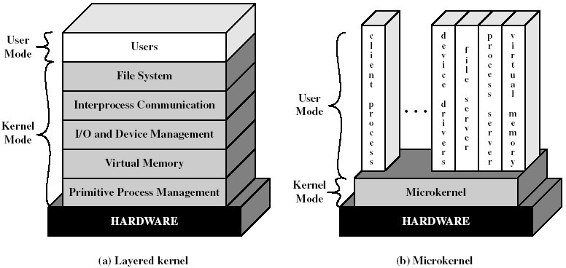
Layered vs. Microkernel Architecture
44
CS-2006 Operating Systems

Slide 45
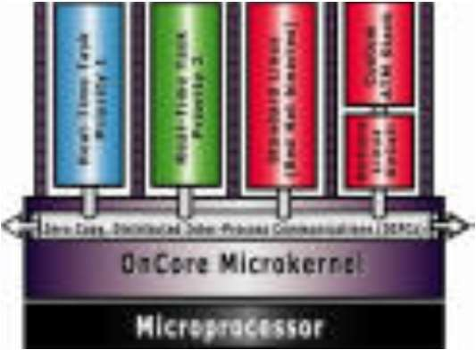
Microkernel System Structure
Communication takes place between user modules using message passing
Benefits:
Easier to extend a microkernel
Easier to port the operating system to new architectures
More reliable (less code is running in kernel mode)
More secure
Detriments:
Performance overhead of user space to kernel space communication
45
CS-2006 Operating Systems

Slide 46
Microkernel System Structure
Application Program
File System
Device Driver
user mode
messages
messages
Interprocess Communication
memory managment
CPU
scheduling
kernel mode
microkernel
hardware

Slide 47
Benefits of a Microkernel Organization
Extensibility/Reliability
modular design
easier to extend a microkernel
more reliable (less code is running in kernel mode)
more secure (less code to be validated in kernel)
small microkernel can be rigorously tested
Portability
changes needed to port the system to a new processor is done in the microkernel, not in the other services.
47

Slide 48
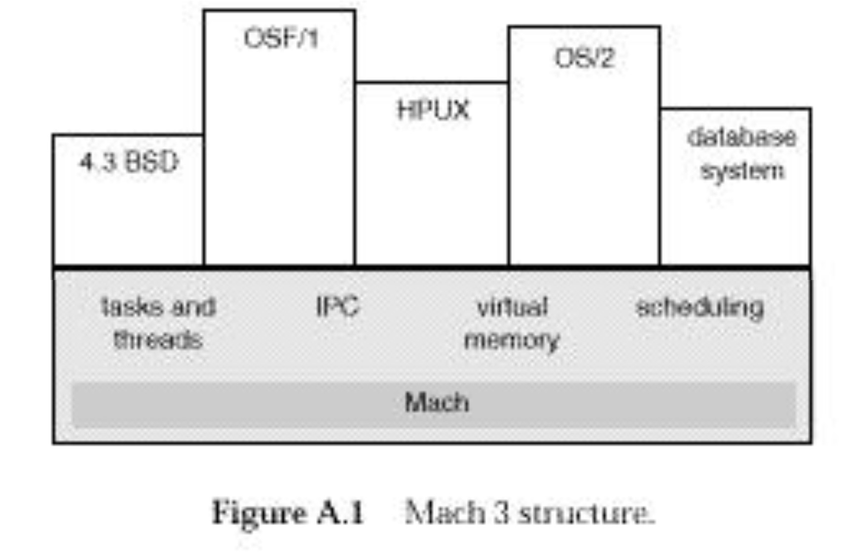
Mach 3 Microkernel Structure
48
CS-2006 Operating Systems

Slide 49
Kernel Modules
Most modern operating systems implement kernel modules
Uses object-oriented approach
Each core component is separate
Each talks to the others over known interfaces
Each is loadable as needed within the kernel
Overall, similar to layers but more flexible
49
CS-2006 Operating Systems

Slide 50
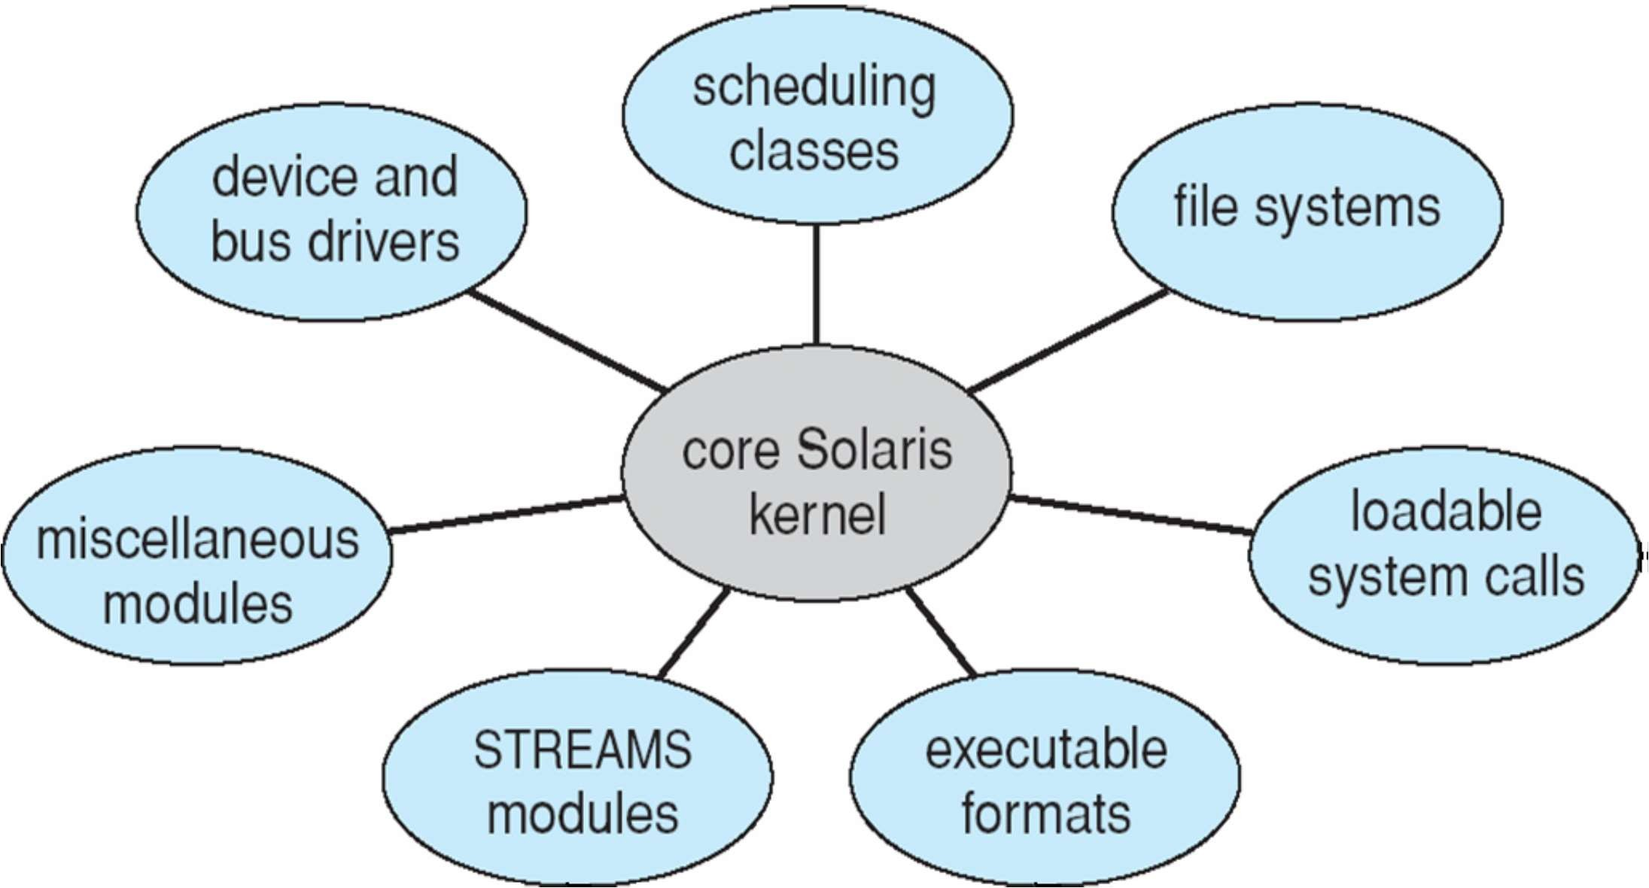
Solaris Modular Approach
50
CS-2006 Operating Systems

Slide 51
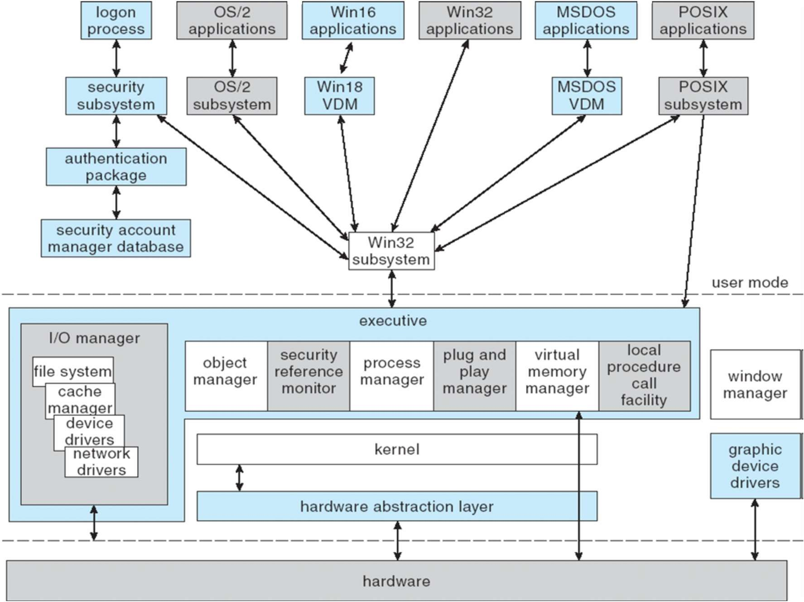
XP Architecture
51
CS-2006 Operating Systems

Slide 52
4. Virtual Machines
A virtual machine takes the layered approach to its logical next step. It treats hardware and the operating system kernel as though they were all hardware
A virtual machine provides an interface identical to the underlying bare hardware
The operating system host creates the illusion that a process has its own processor (and virtual memory)
Each guest provided with a (virtual) copy of underlying computer

Slide 53
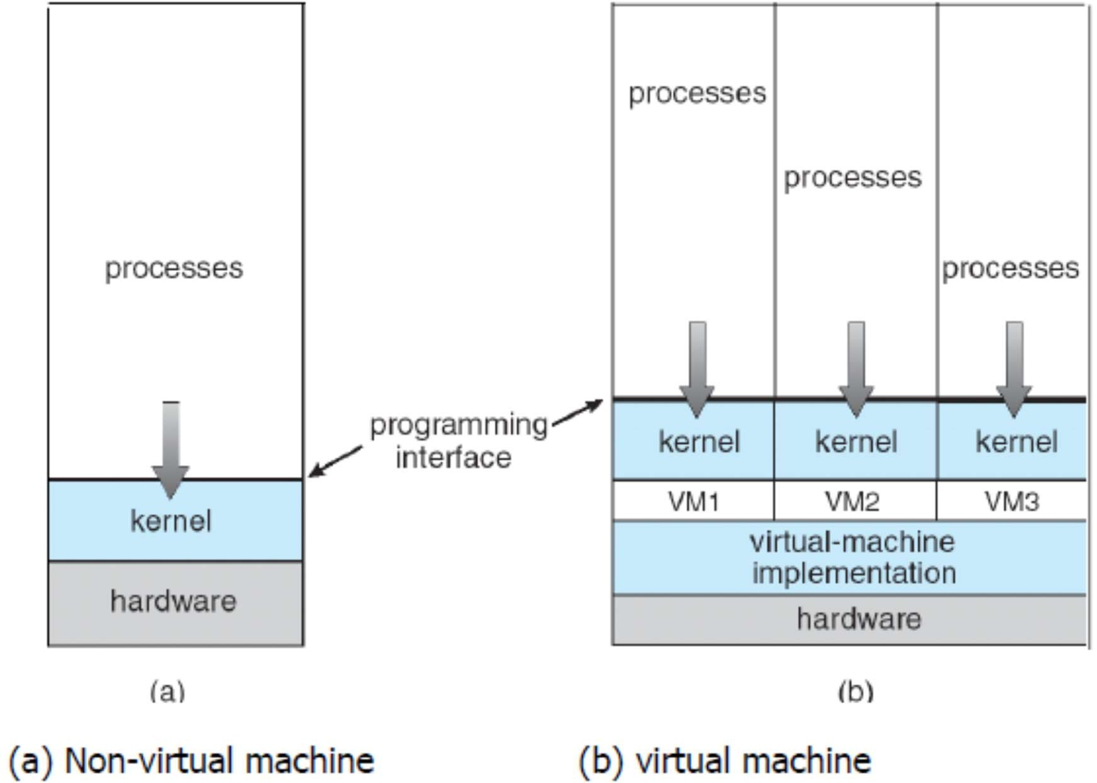
Virtual Machines (Cont.)

Slide 54
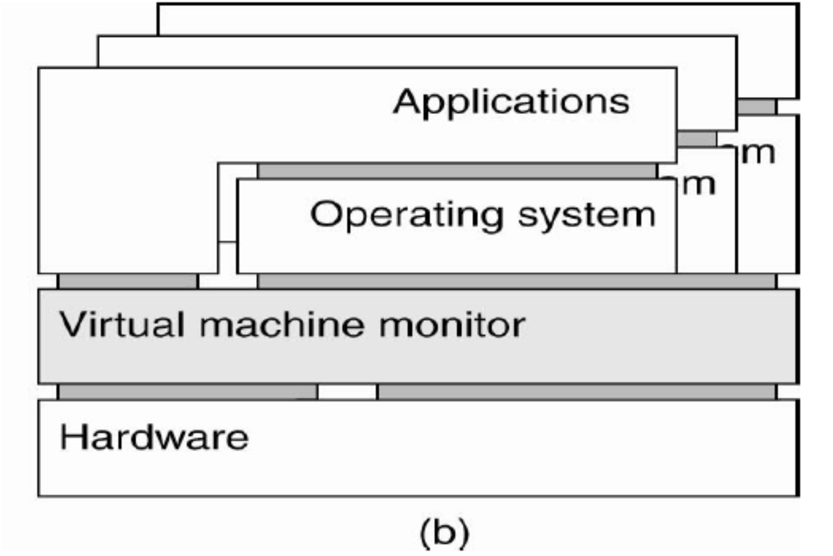
Hypervisor / VMM

Slide 55
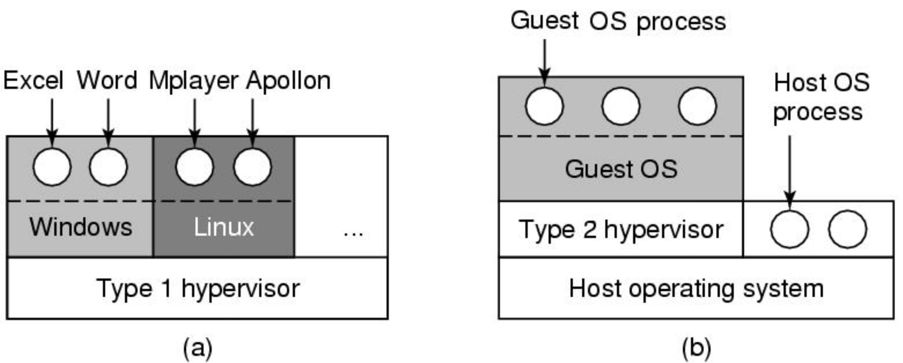
Types of Hypervisors
(a) A type 1 hypervisor
(b) A type 2 hypervisor

Slide 56
Para- vs. Full-virtualization
Presents guest with system similar but not identical to hardware
Guest must be modified to run on paravirtualized hardware
Guest can be an OS, or in the case of Solaris 10 applications running in containers
Full-virtualization: unmodified guest OSes

Slide 57
References
 Operating System Concepts (Silberschatz, 9th edition) Chapter 1, 2.1-2.5
57

